Slide 1

Fall Detection System Using Sensors Embedded In Smartphones
By,
Jathin Sreenivas,
Vineeth Bhat,
Vidya Gopalakrishnarao

Slide 2
Project Vision
Smartphones are embedded with sensors using which we can extract data to perform various human activity recognition. This projects uses that idea to detect a fall and propose a fall detection system using sensors embedded in smartphones.
Fall detection application will detect fall during normal activities like standing, sitting, walking or during accidents like falling.[1]

Slide 3
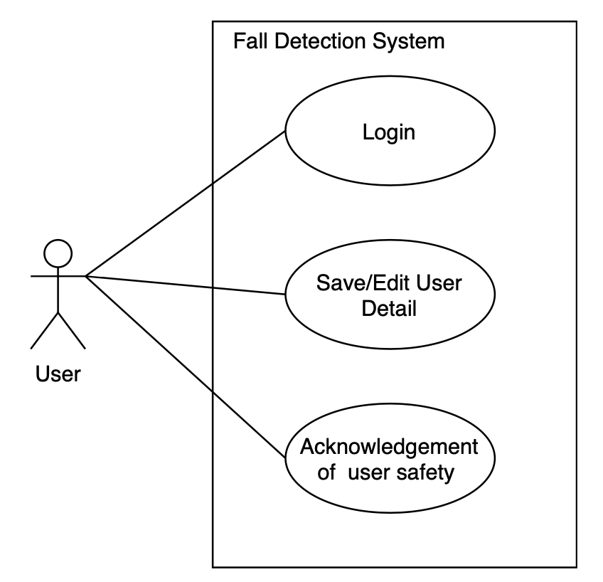
Use Case

Slide 4
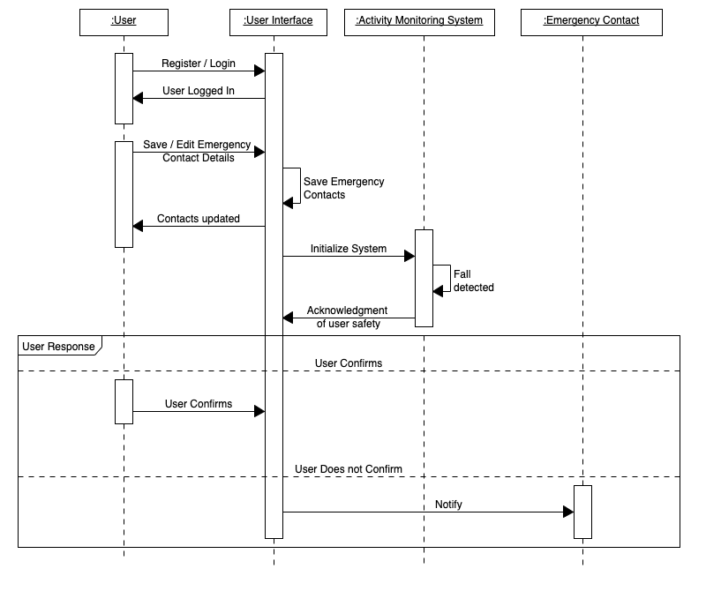
Sequence Diagram

Slide 5
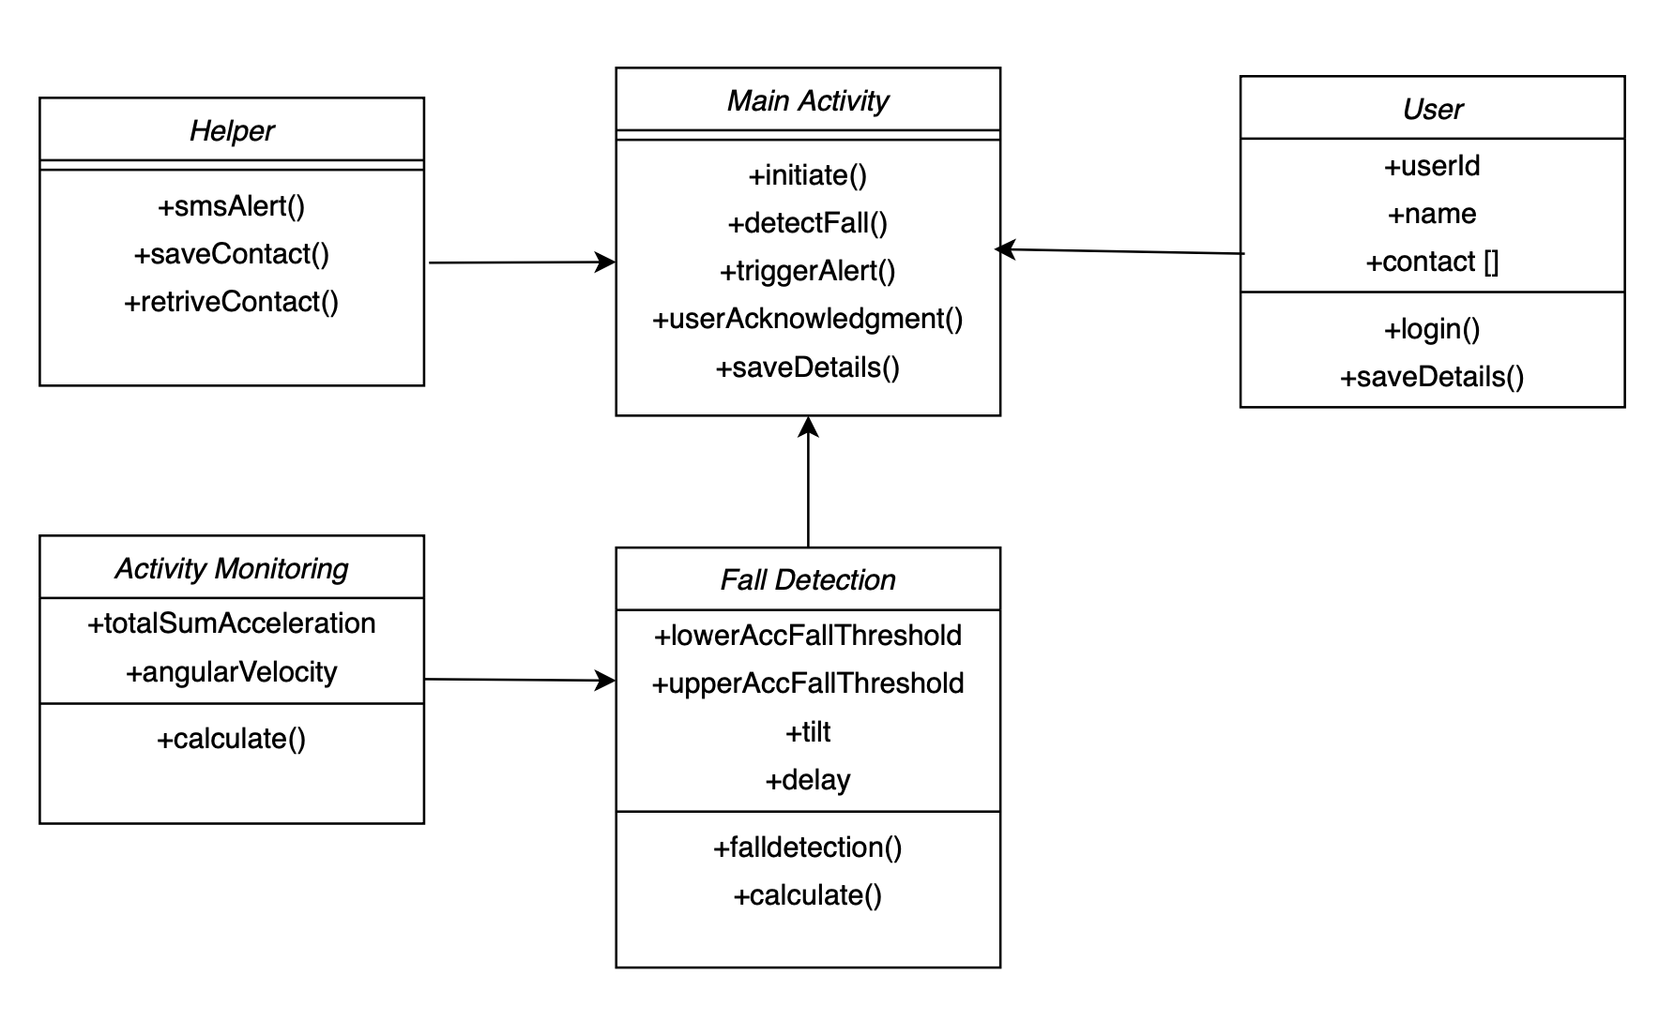
Class Diagram

Slide 6
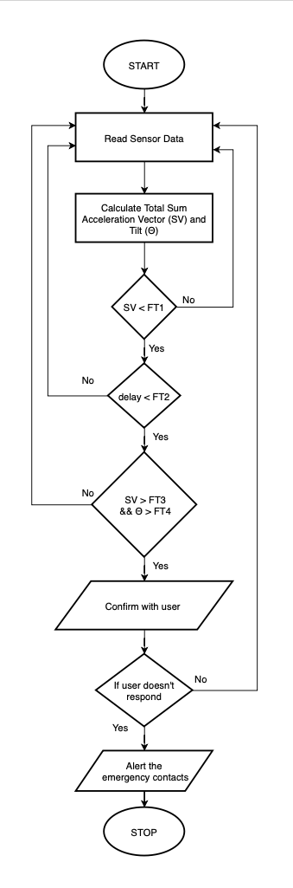
Flowchart

Slide 7
References
[1] S. Abdelhedi, R. Bourguiba, J. Mouine and M. Baklouti, ”Development of a two-threshold-based fall detection algorithm for elderly health monitoring,” 2016 IEEE Tenth International Conference on Research Challenges in Information Science (RCIS), Grenoble, 2016, pp. 1-5, doi: 10.1109/RCIS.2016.7549315.
[2] Bourke, Alan O´ Laighin, Gearo´id. (2008). A threshold-based falldetection algorithm using a bi-axial gyroscope sensor. Medical engineering physics. 30. 84-90. 10.1016/j.medengphy.2006.12.001.
[3] H. W. Guo, Y. T. Hsieh, Y. S. Huang, J. C. Chien, K. Haraikawa and J. S. Shieh, ”A threshold-based algorithm of fall detection using a wearable device with tri-axial accelerometer and gyroscope,” 2015 International Conference on Intelligent Informatics and Biomedical Sciences (ICIIBMS), Okinawa, 2015, pp. 54-57, doi: 10.1109/ICIIBMS. 2015.7439470.

